Slide 1
Cache Memory
Md. Foysal Mahmud
Roll: 14CSE028
Dpt. Of CSE.
University of
Barisal

Slide 2
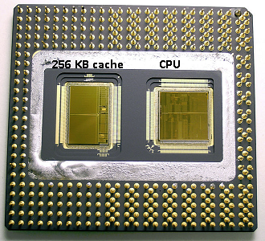

Slide 3
What is cache memory?
A CPU cache is a cache used by the central processing unit of a computer to reduce the average time to access memory. The cache is a smaller, faster memory which stores copies of the data from the most frequently used main memory locations. As long as most memory accesses are cached memory locations, the average latency of memory accesses will be closer to the cache latency than to the latency of main memory

Slide 4

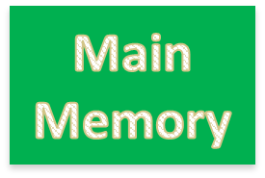

What is Cache Memory?
Cache memory is used in order to achieve higher performance of CPU by allowing the CPU to access data at faster speed.
It is placed closest to the processor in the computer assembly.
It is way too costly.
It is also a type of memory but keeping in mind the cost factor it cannot be used as a primary memory.

Slide 5
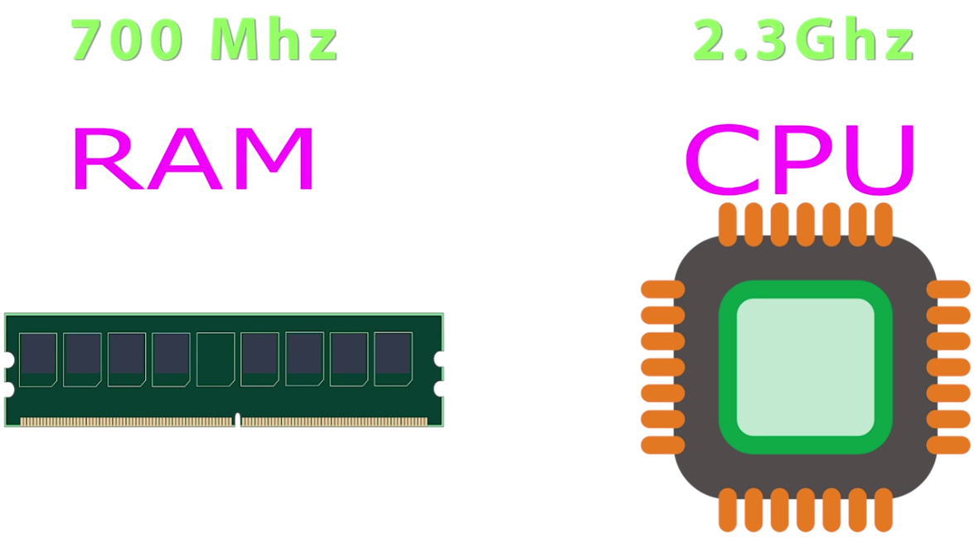

Slide 6
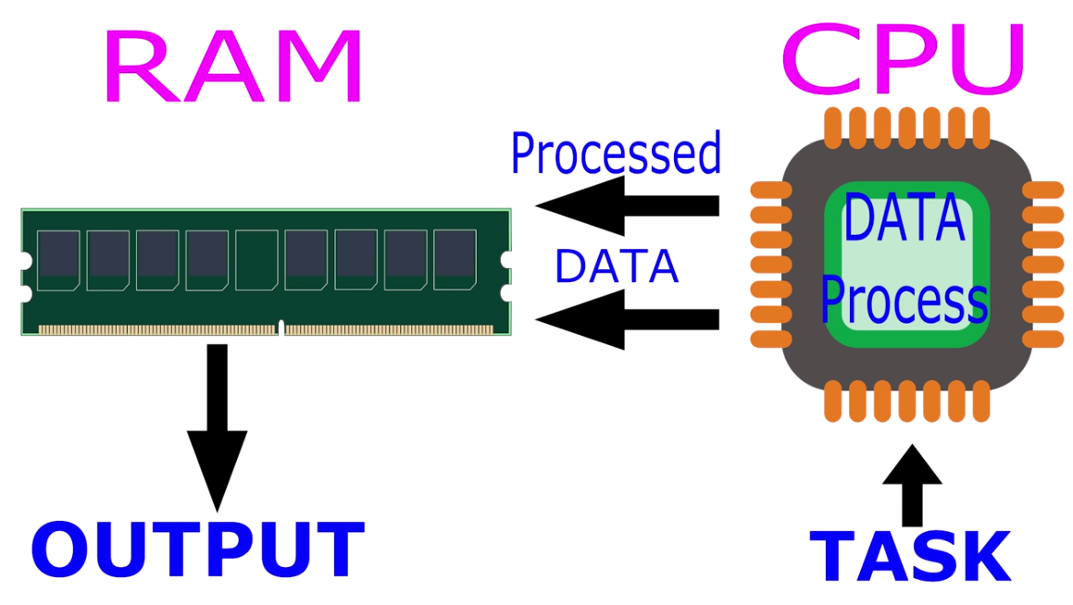

Slide 7
Characteristics of Cache Memory
Location
Capacity
Unit of transfer
Access method
Performance
Physical type
Physical characteristics
Organisation

Slide 8
Location
CPU
Internal
External

Slide 9
Capacity
Word size
  The natural unit of organisation
For example, the
CRAY C90 (an older model CRAY supercomputer) has a 64-bit word length but uses a 46-bit integer representation.
The Intel x86 architecture has a wide variety of instruction lengths, expressed as multiples of bytes, and a word size of 32 bits.
Number of words
  or Bytes

Slide 10
Unit of Transfer
Internal
  Usually governed by data bus width
External
  Usually a block which is much larger than a word
Addressable unit
  Smallest location which can be uniquely addressed
  Word internally
  Cluster on M$ disks

Slide 11
Access Methods (1)
Sequential
  Start at the beginning and read through in order
  Access time depends on location of data and previous location
  e.g. tape
Direct
  Individual blocks have unique address
  Access is by jumping to vicinity plus sequential search
  Access time depends on location and previous location
  e.g. disk

Slide 12
Access Methods (2)
Random
  Individual addresses identify locations exactly
  Access time is independent of location or previous access
  e.g. RAM
Associative
  Data is located by a comparison with contents of a portion of the store
  Access time is independent of location or previous access
  e.g. cache

Slide 13
Memory Hierarchy
Registers
  In CPU
Internal or Main memory
  May include one or more levels of cache
  “RAM”
External memory
  Backing store

Slide 14

Memory Hierarchy - Diagram

Slide 15
Performance
Access time
  Time between presenting the address and getting the valid data
Memory Cycle time
  Time may be required for the memory to “recover” before next access
  Cycle time is access + recovery
Transfer Rate
  Rate at which data can be moved

Slide 16
Cache
Small amount of fast memory
Sits between normal main memory and CPU
May be located on CPU chip or module

Slide 17
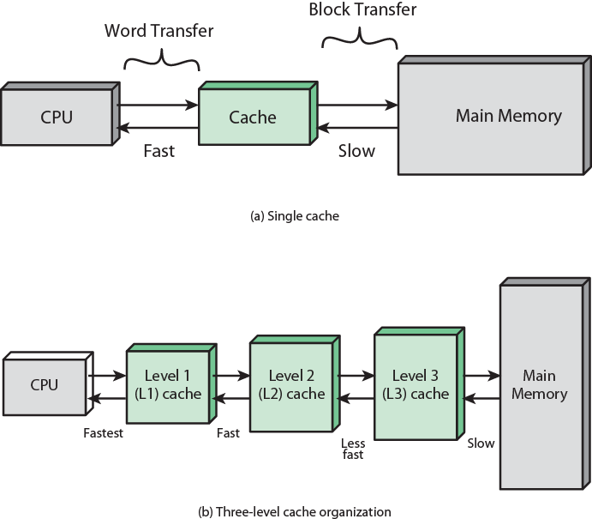

Slide 18
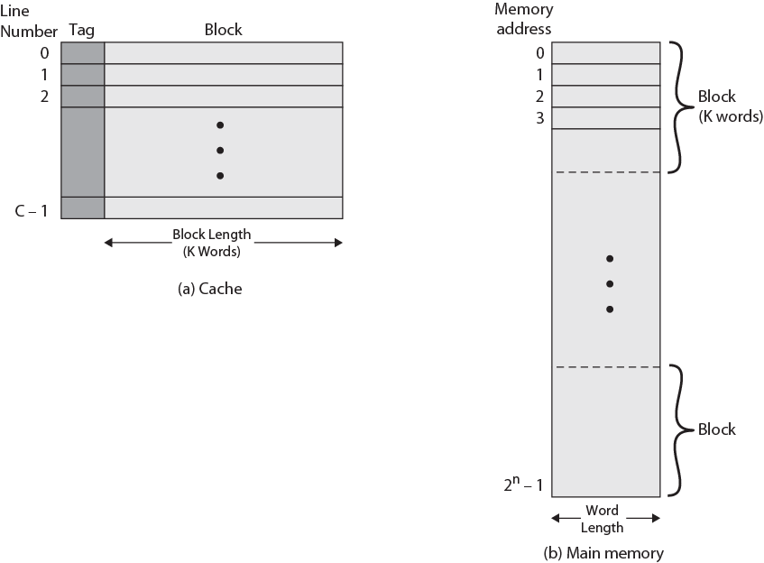

Slide 19
Cache operation – overview
CPU requests contents of memory location
Check cache for this data
If present, get from cache (fast)
If not present, read required block from main memory to cache
Then deliver from cache to CPU
Cache includes tags to identify which block of main memory is in each cache slot

Slide 20
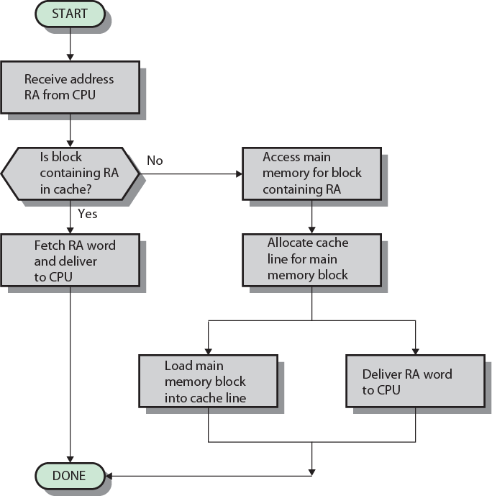
Cache Read Operation - Flowchart

Slide 21
Cache Design
Addressing
Size
Mapping Function
Replacement Algorithm
Write Policy
Block Size
Number of Caches

Slide 22
Cache Addressing
Where does cache sit?
  Between processor and virtual memory management unit
  Between MMU and main memory
Logical cache (virtual cache) stores data using virtual addresses
  Processor accesses cache directly, not thorough physical cache
  Cache access faster, before MMU address translation
  Virtual addresses use same address space for different applications
    Must flush cache on each context switch
Physical cache stores data using main memory physical addresses

Slide 23
Size does matter
Cost
  More cache is expensive
Speed
  More cache is faster (up to a point)
  Checking cache for data takes time

Slide 24
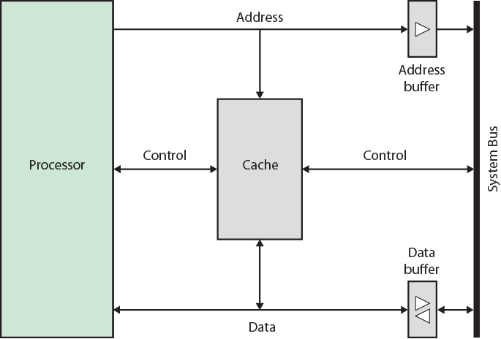
Typical Cache Organization

Slide 25
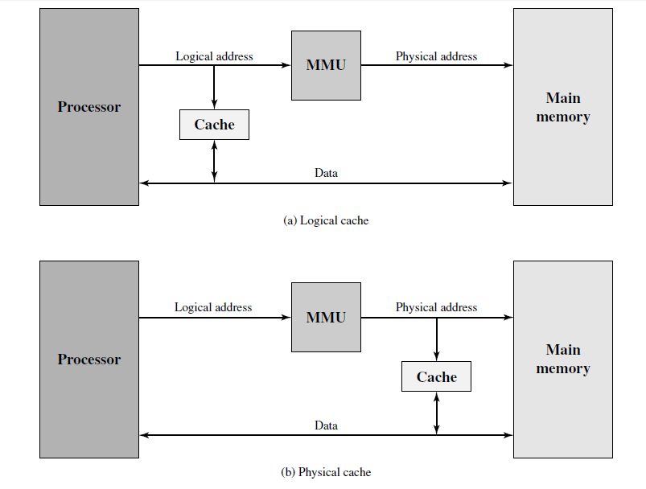
Logical and Physical Caches

Slide 26
Comparison of Cache Sizes
Processor
Type
Year of Introduction
L1 cache
L2 cache
L3 cache
IBM 360/85
Mainframe
1968
16 to 32 KB
—
—
PDP-11/70
Minicomputer
1975
1 KB
—
—
VAX 11/780
Minicomputer
1978
16 KB
—
—
IBM 3033
Mainframe
1978
64 KB
—
—
IBM 3090
Mainframe
1985
128 to 256 KB
—
—
Intel 80486
PC
1989
8 KB
—
—
Pentium
PC
1993
8 KB/8 KB
256 to 512 KB
—
PowerPC 601
PC
1993
32 KB
—
—
PowerPC 620
PC
1996
32 KB/32 KB
—
—
PowerPC G4
PC/server
1999
32 KB/32 KB
256 KB to 1 MB
2 MB
IBM S/390 G4
Mainframe
1997
32 KB
256 KB
2 MB
IBM S/390 G6
Mainframe
1999
256 KB
8 MB
—
Pentium 4
PC/server
2000
8 KB/8 KB
256 KB
—
IBM SP
High-end server/ supercomputer
2000
64 KB/32 KB
8 MB
—
CRAY MTAb
Supercomputer
2000
8 KB
2 MB
—
Itanium
PC/server
2001
16 KB/16 KB
96 KB
4 MB
SGI Origin 2001
High-end server
2001
32 KB/32 KB
4 MB
—
Itanium 2
PC/server
2002
32 KB
256 KB
6 MB
IBM POWER5
High-end server
2003
64 KB
1.9 MB
36 MB
CRAY XD-1
Supercomputer
2004
64 KB/64 KB
1MB
—

Slide 27
Mapping Function
Cache of 64kByte
Cache block of 4 bytes
  i.e. cache is 16k (2¹⁴) lines of 4 bytes
16MBytes main memory
24 bit address
  (2²⁴=16M)

Slide 28
Direct Mapping
Each block of main memory maps to only one cache line
  i.e. if a block is in cache, it must be in one specific place
Address is in two parts
Least Significant w bits identify unique word
Most Significant s bits specify one memory block
The MSBs are split into a cache line field r and a tag of s-r (most significant)

Slide 29
Direct Mapping Address Structure
Tag s-r
Line or Slot r
Word w
8
14
2
24 bit address
2 bit word identifier (4 byte block)
22 bit block identifier
  8 bit tag (=22-14)
  14 bit slot or line
No two blocks in the same line have the same Tag field
Check contents of cache by finding line and checking Tag

Slide 30
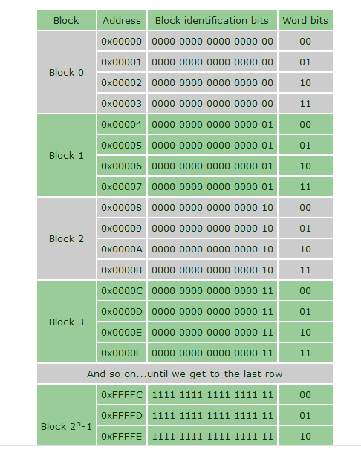

Slide 31
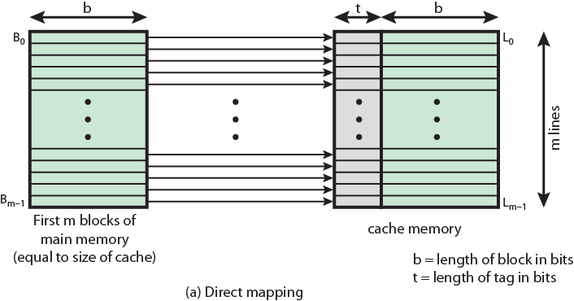
Direct Mapping from Cache to Main Memory

Slide 32
Direct Mapping Cache Line Table
Cache line | Main Memory blocks held
0 | 0, m, 2m, 3m…2s-m
1 | 1,m+1, 2m+1…2s-m+1
…
m-1 | m-1, 2m-1,3m-1…2s-1

Slide 33
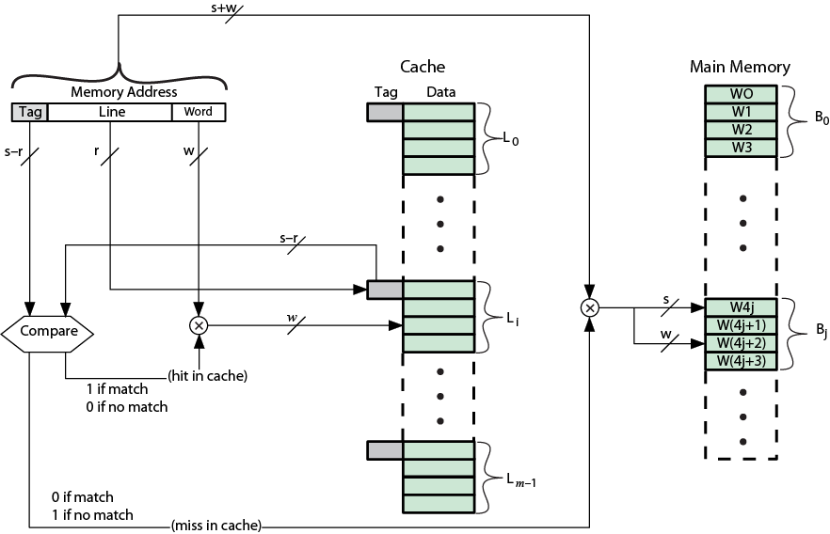
Direct Mapping Cache Organization

Slide 34
Direct Mapping Summary
Address length = (s + w) bits
Number of addressable units = 2s+w words or bytes
Block size = line size = 2w words or bytes
Number of blocks in main memory = 2s+ w/2w = 2s
Number of lines in cache = m = 2r
Size of tag = (s – r) bits

Slide 35
Associative Mapping
A main memory block can load into any line of cache
Memory address is interpreted as tag and word
Tag uniquely identifies block of memory
Every line’s tag is examined for a match
Cache searching gets expensive

Slide 36
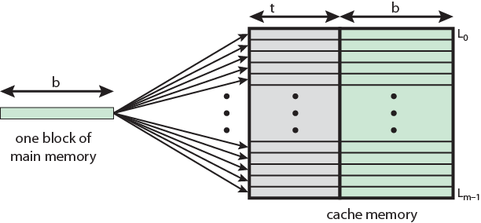
Associative Mapping from
Cache to Main Memory

Slide 37
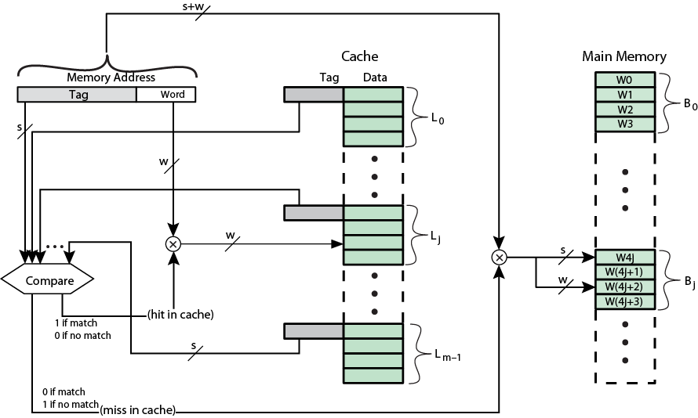
Fully Associative Cache Organization

Slide 38
Associative Mapping
Address Structure
Word
2 bit
Tag 22 bit
22 bit tag stored with each 32 bit block of data
Compare tag field with tag entry in cache to check for hit
Least significant 2 bits of address identify which 16 bit word is required from 32 bit data block
e.g.
  Address Tag Data Cache line
  FFFFFC FFFFFC 24682468 3FFF

Slide 39
Associative Mapping Summary
Address length = (s + w) bits
Number of addressable units = 2s+w words or bytes
Block size = line size = 2w words or bytes
Number of blocks in main memory = 2s+ w/2w = 2s
Number of lines in cache = undetermined
Size of tag = s bits

Slide 40
Replacement Algorithms (1)
Direct mapping
No choice
Each block only maps to one line
Replace that line

Slide 41
Replacement Algorithms (2)
Associative & Set Associative
Hardware implemented algorithm (speed)
Least Recently used (LRU)
e.g. in 2 way set associative
  Which of the 2 block is lru?
First in first out (FIFO)
  replace block that has been in cache longest
Least frequently used
  replace block which has had fewest hits
Random

Slide 42
ARM Cache Organization
Small FIFO write buffer
  Enhances memory write performance
  Between cache and main memory
  Small c.f. cache
  Data put in write buffer at processor clock speed
  Processor continues execution
  External write in parallel until empty
  If buffer full, processor stalls
  Data in write buffer not available until written
    So keep buffer small

Slide 43
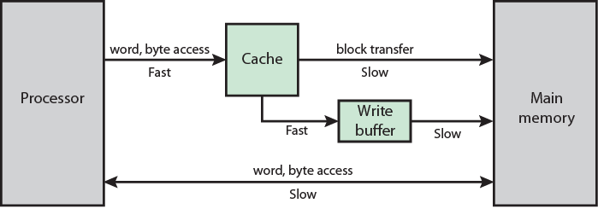
ARM Cache and Write Buffer Organization

